Slide 1

STUDENTS PERFOMANCE ANALYSIS
By Data Groups

Slide 2

Data collection
Aim of the project
Data sources
- Kaggle
- Google-sheets
Phpmyadmin
Looker studio

Slide 3

Data cleaning and processing
Checking for missing values
Duplicates
Normalizing and standardizing data
Derived columns for average score and results

Slide 4
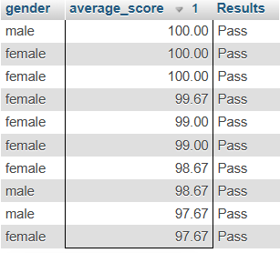
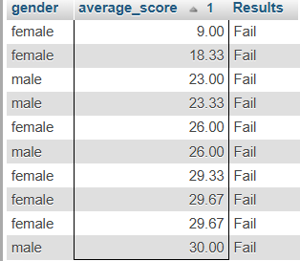
Data integration and analysis
Relationship between gender and marks
Summary table and matrix

Slide 5
Visualization & Reporting
Average marks by gender
Distribution per subject
Pass/fail ratios
Looker studio link( https://lookerstudio.google.com/reporting/4fb1225b-fc31-4b9c-97b0-cae80793a221/page/5dnIF )
GITHUB Link (https://github.com/PrideNgomane/Student-Performance-insight-Dashboard )

Slide 6
CONCLUSION
Implications and recommendations

Slide 7

QUESTION AND ANSWERS

